Slide 1
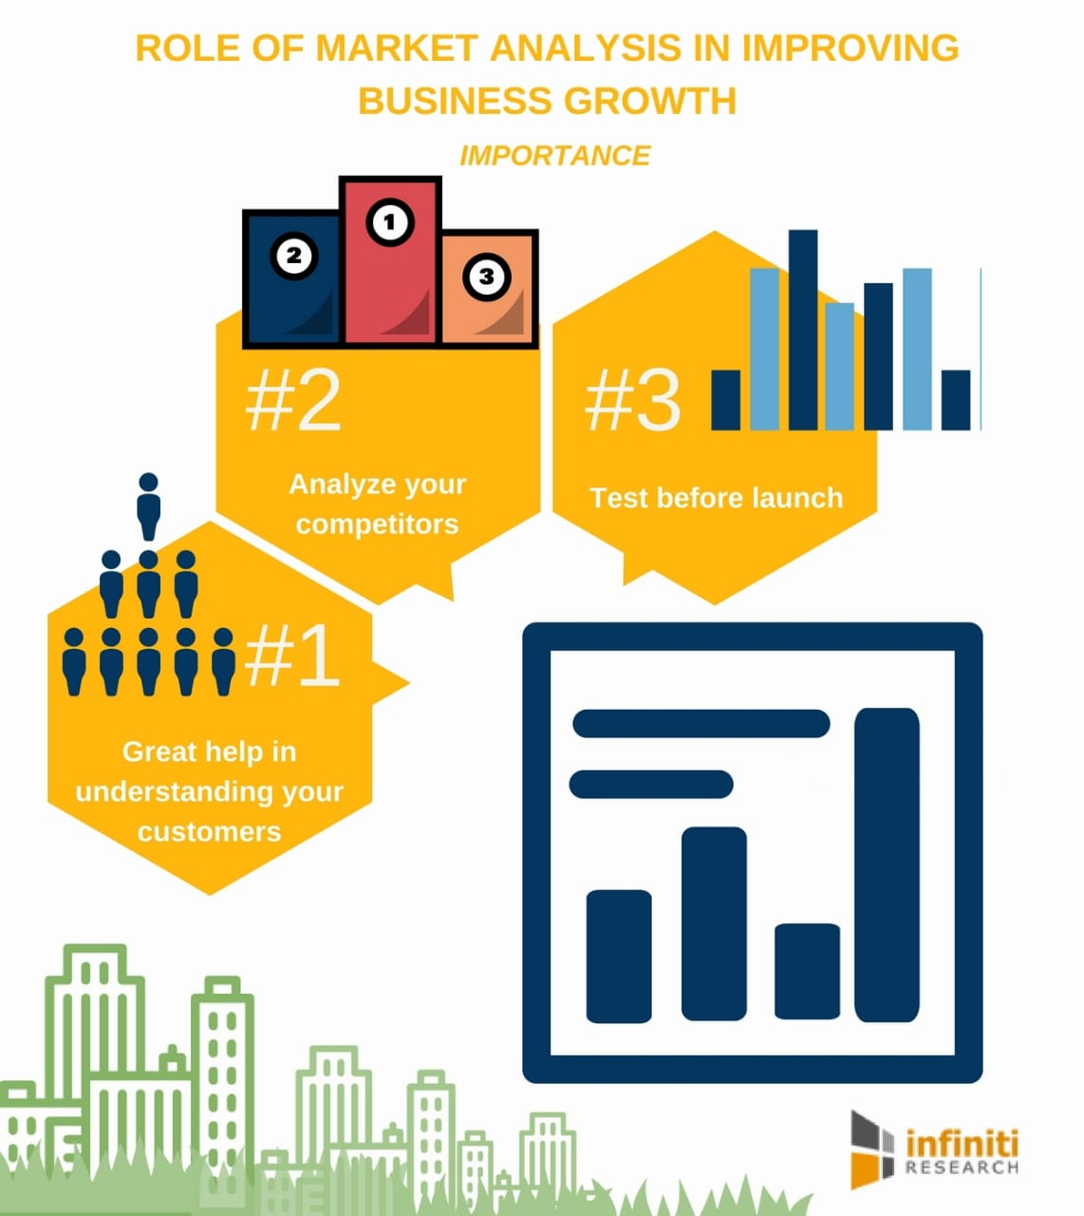
PROJECT TITLE
UNVEILING MARKET INSIGHTS; ANALYSING SPENDING BEHAVIOUR AND IDENTIFYING OPPORTUNITIES FOR GROWTH
TEAM ID :NM2023TMID08095
TEAM LEADER: ABINAYA K S
TEAM MEMBERS: ABI P
ABISHA C F
ABISHMA V

Slide 2
PROJECT REPORT
INTRODUCTION
OVERVIEW
PURPUSE
PROBLEM DEFINITION AND DESIDN THINKING
EMPATHY MAP
IDEATION AND BRAIN STROMING MAP
RESULT
ADVANTAGES AND DISADVANTAGES
APPLICATION
CONCLUSION
FUTURE SCOPE

Slide 3
UNVEILING MARKET INSIGHTS :ANAIYSING SPENDING BEHAVIOUR AND IDENTIFYING OPPURTUNITIES FOR GROWTH
1
INTRODUCTION
Unveiling market insights :Analyzing spending behavior and identifying opportunities for growth In this exploration of consumer behavior and market dynamics ,we will delve into the intricacies of how people spend their hard earned money and discover the hidden opportunities for businesses to thrive in an ever evolving market place . Join us as we unravel the intricacies of consumer choices and unveil marketplace. Join us as we unravel the intricacies of consumer choices and unveil strategies for sustainable growth

Slide 4
2
PURPOSE
Unveiling market insights serves the purpose of analyzing consumer spending behavior and identifying opportunities for business growth. By understanding how consumers allocate their resources and where they allocate them, companies can make informed decision to better target their products or services refine their marketing strategies and expand into new markets or products offerings .This process ultimately helps businesses adapt and thrive in a dynamic and competitive market.

Slide 5
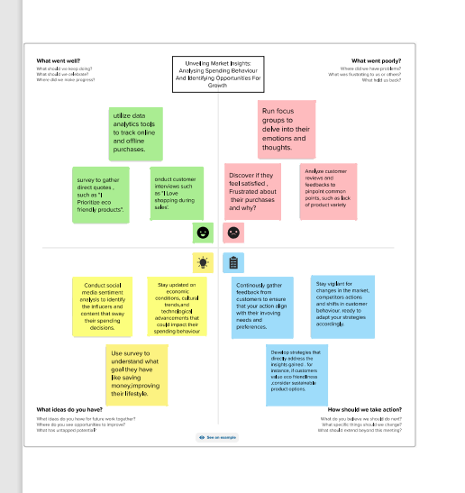
PROBLEM DEFINITION AND DESIGN THINKING
The objective of the problem definition in unveiling market insights is analyzing the spending behavior provides valuable data enable businesses to make informed decisions based on the real customer trends
1
EMPATHY MAP

Slide 6
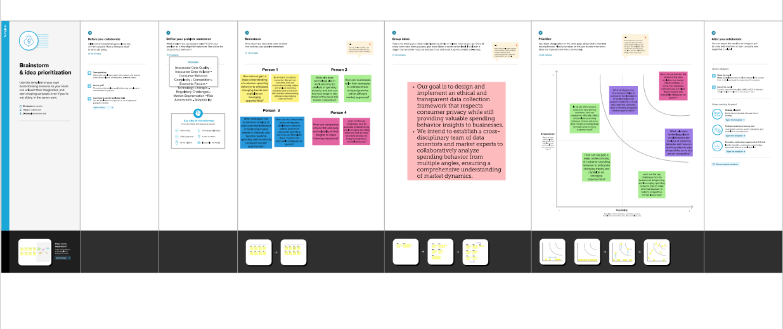
2 . IDEATION AND BRAINSTORMING MAP

Slide 7
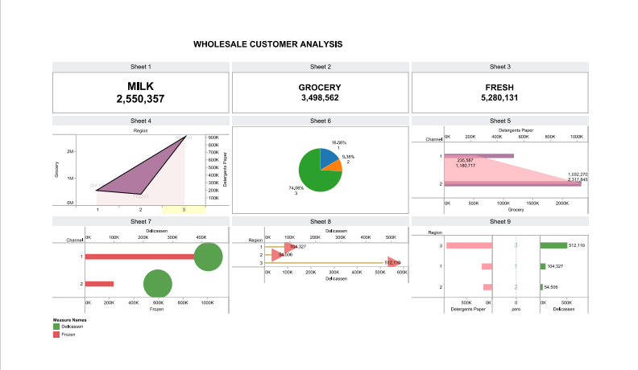
RESULT
3.
DASHBOARD

Slide 8

STORY

Slide 9


Slide 10
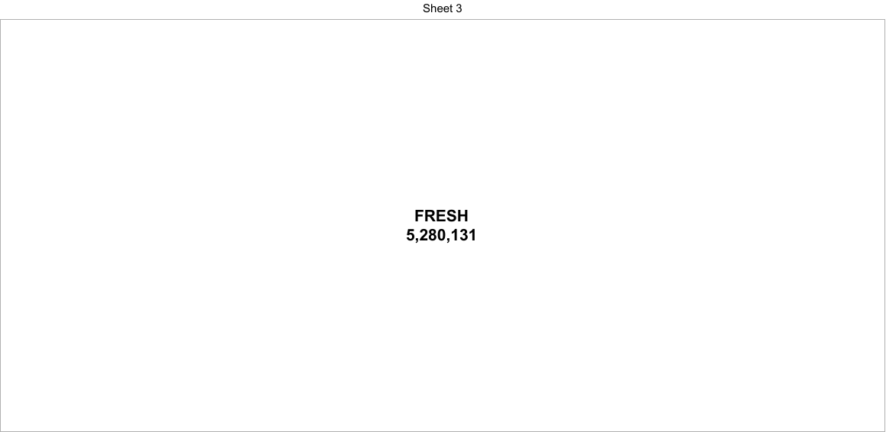

Slide 11
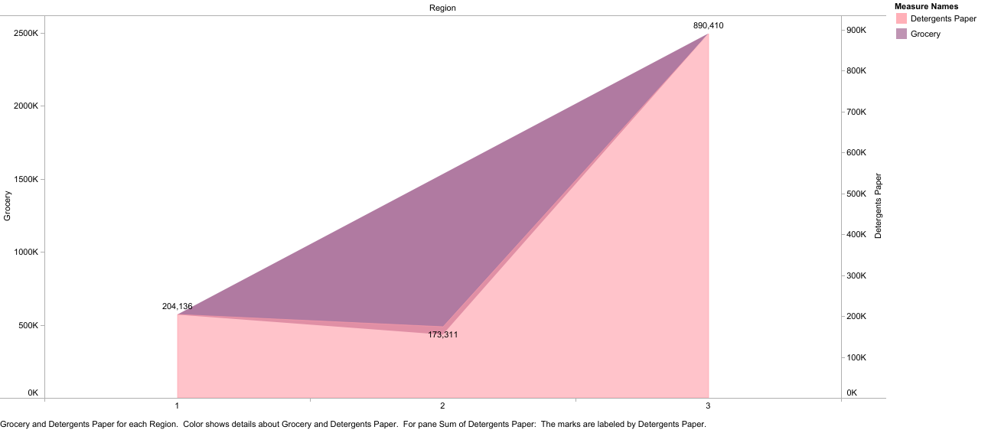

Slide 12
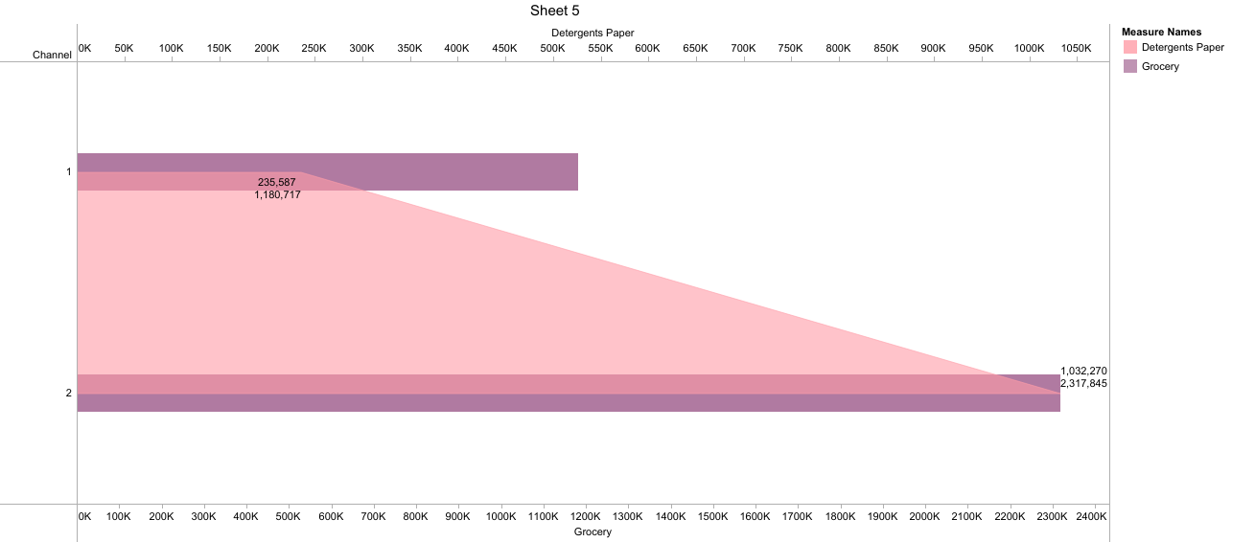

Slide 13
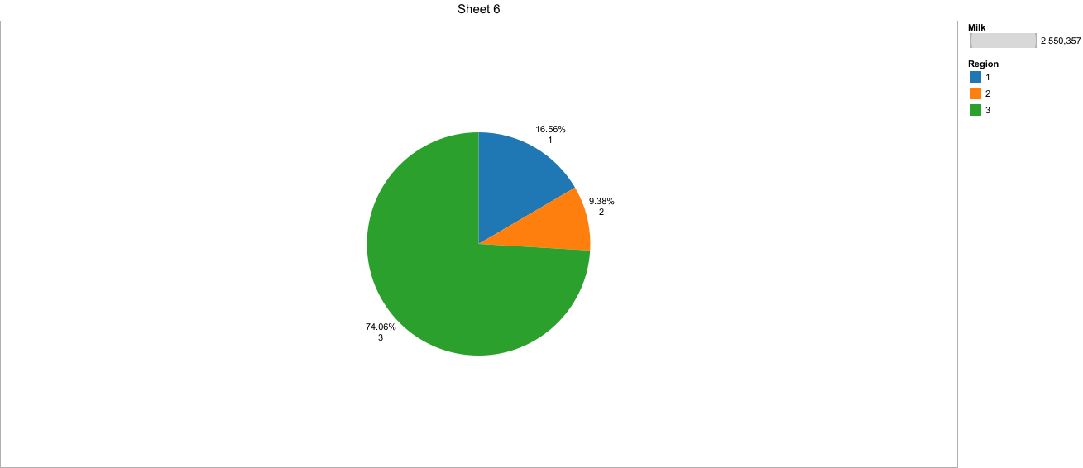

Slide 14
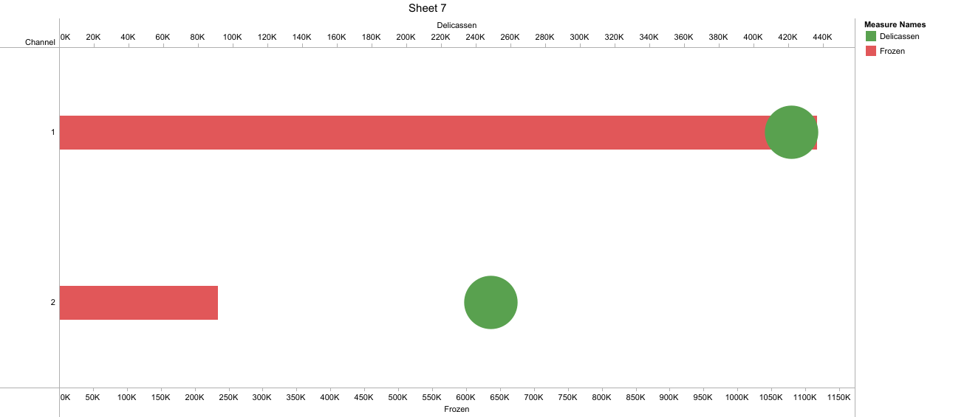

Slide 15
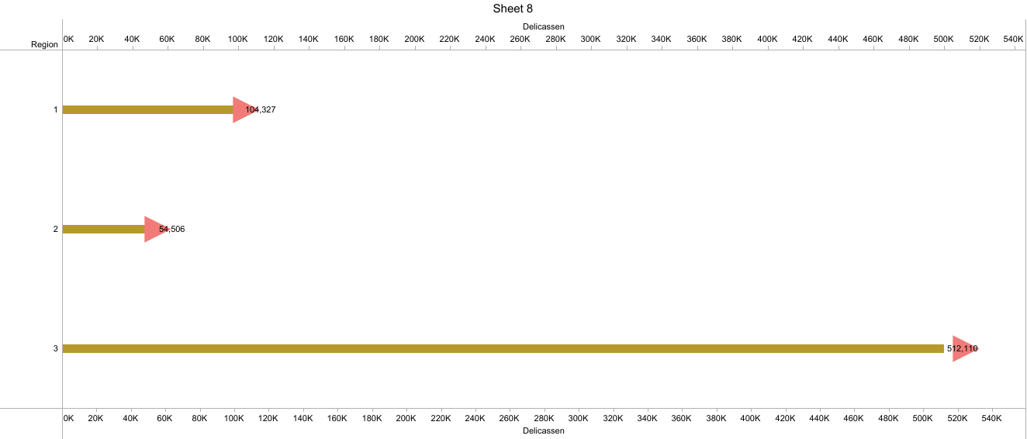

Slide 16
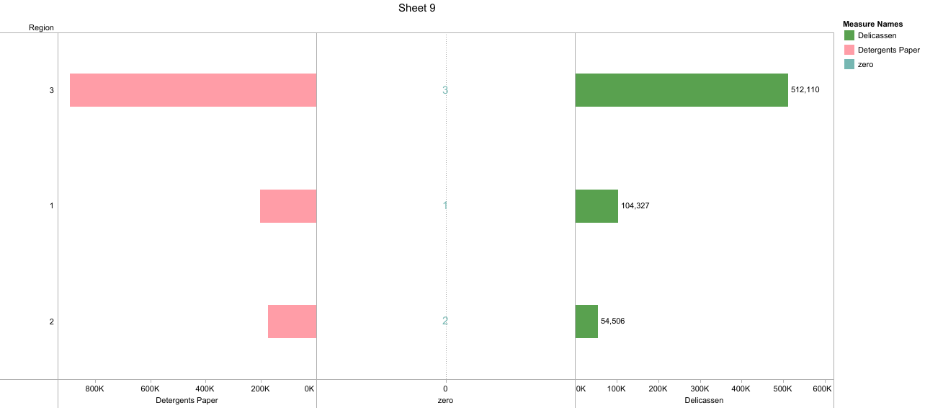

Slide 17
4. ADVANTAGES AND DISADVANTAGES
ADVANTAGES
1.Data Driven Decision Making : Analyzing spending behavior provides valuable data enabling businesses to make informed decision based on real customer trends
2.Identifying Growing Opportunities : Market insights can uncover untapped market segment and emerging trends allowing businesses to capitalize on new opportunities for expansion and revenue growth
3.Competitive Advantage : With insights into market trends businesses can stay ahead of competition by adapting their strategies to align with market demand

Slide 18
DISADVANTAGES
1 . Data Accuracy : The quality of market insights depends on the accuracy of the data collected .Inaccurate data can lead to misguided decision and wasted resources
2.Cost and resources : Gathering and analyzing market insights can be resource intensive requiring investments in technology expertise and time
3. Market Volatility: Market can change rapidly and insights might become outdated quickly making it essential for businesses to maintain a continuous analysis process

Slide 19
5. APPLICATION
The unveiling market insights application listed below :
1. Global Expansion : Expanding the research to international markets for the broader perspective on spending behavior
2 . Mobile Commerce Insights : Focusing on mobile spending trends as smartphone usage continues to rise.
3.Ethnographic research : Conducting in depth ethnographic studies to gain a deeper understanding of consumer behavior

Slide 20
6. CONCLUSION :
The conclusion of the report “Unveiling market insights :Analyzing spending behavior and identifying opportunities for growth” highlights the key findings and takeaway from the analysis . It emphasizes the importance of the understanding consumer spending behavior in order to make informed business decision and seize growth opportunities .The conclusion may also provide recommendations for businesses to leverage the identified insights and adapt their strategies for sustained growth in the market.

Slide 21
7 . FUTURE SCOPE
1 .Artificial intelligence
2. Personalization.
3. Industry specific insights
4. Competitive benchmarking.
5. Consumer feed back and so on.

